Slide 1

Impact of Transaction Characteristics on Fraud Detection
Edith Tache | Cali Hugelen | Jacob Brooks | Remington Webb
Notes:
https://unsplash.com/photos/glass-window-building-vLN225oj0ck

Slide 2
Agenda
01
Introduction
02
Key Data Analysis
03
Model Summary
04
Conclusion

Slide 3
Introduction

Slide 4
Introduction
Importance of Fraud Detection
Crucial in today's digital financial transactions.
Protects consumers and businesses.
Project Objective
Analyze transaction characteristics using machine learning.
Develop a predictive model to identify fraudulent transactions.
Dataset
Sourced from Kaggle: "Credit Card Fraud Transaction Data.“
Includes features influencing fraud likelihood.

Slide 5
Business Problem & Hypothesis
Problem Statement
Key indicators of fraudulent activity?
Effect of entry modes on fraud?
Role of demographics in fraud prediction?
Predictive model accuracy?
Hypothesis
Transaction characteristics can determine fraud likelihood.
A well-developed model can accurately distinguish fraudulent transactions.

Slide 6
Method
Feature Engineering
Models
Dropped unnecessary columns, encoded variables, normalized features.
Logistic Regression and Random Forest with class weight adjustment for imbalanced data.
Data Preparation
EDA
Model Training & Evaluation
Cleaning
EDA
Model Evaluation
Removed whitespaces, converted data types, handled missing values.
Visualizations plotted to understand the distributions and relationships within the data.
Precision, Recall, F1-Score, ROC-AUC, Confusion Matrix.

Slide 7
Key Analysis

Slide 8
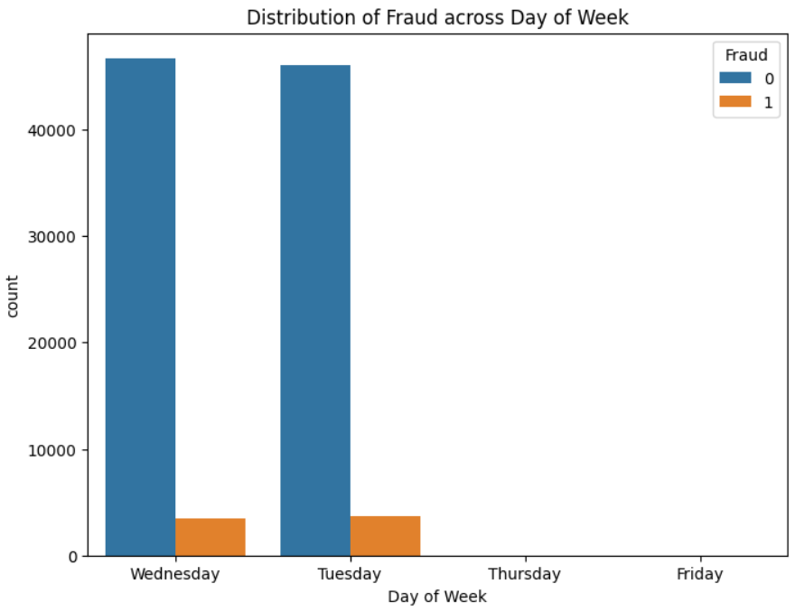
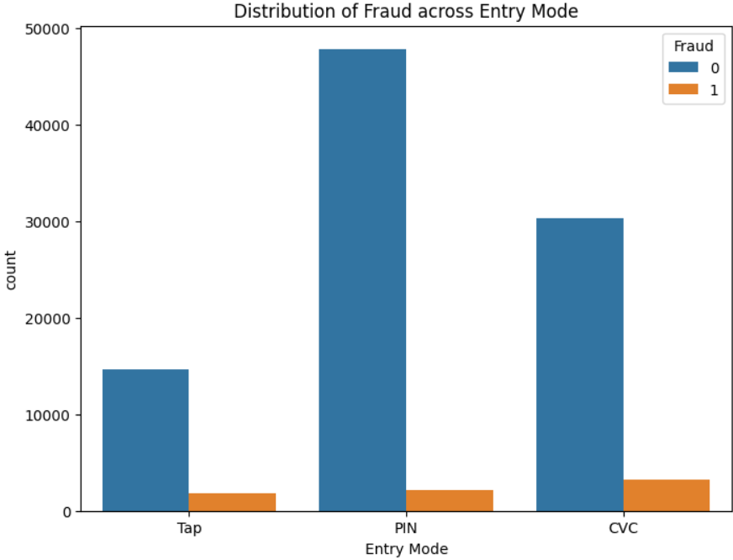
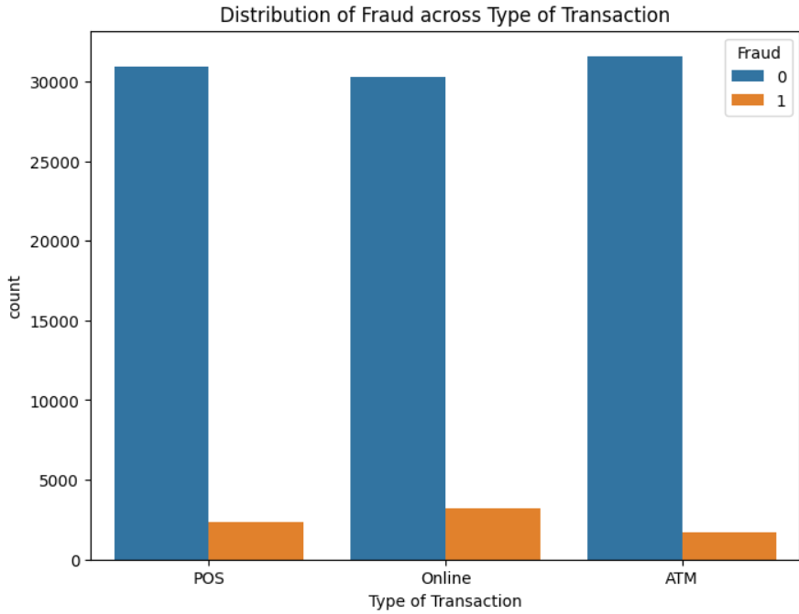
Fraud Characteristics
High fraud on Tuesdays and Wednesdays.
Significant fraud in CVC entry modes.
Higher fraud in online transactions
Slightly higher fraud in Visa Card
Higher fraud in children’s products, electronics, and fashion
UK has high transactions but low fraud; USA, India, Russia, and China have higher fraud proportions..

Slide 9
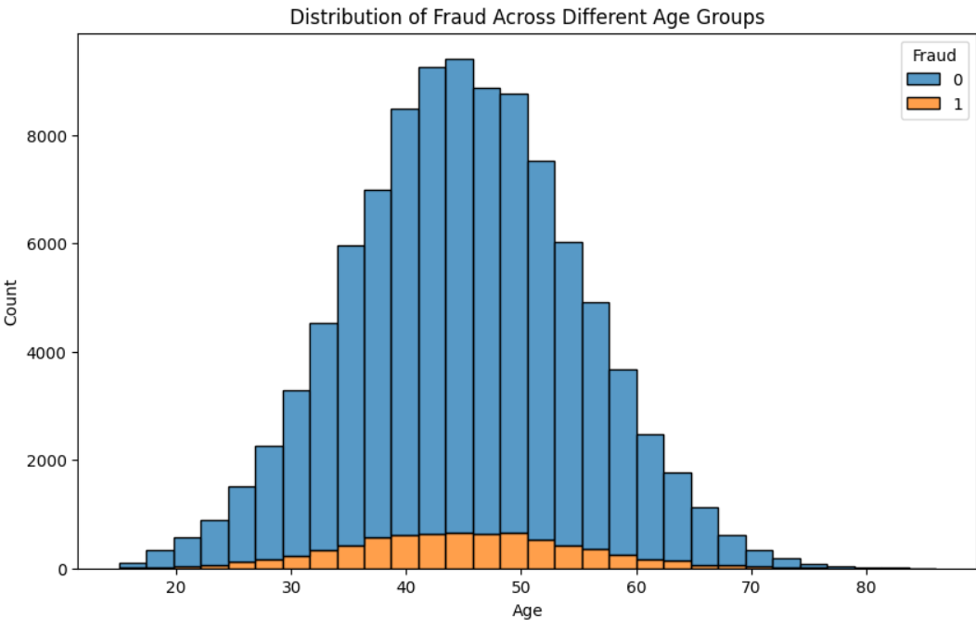
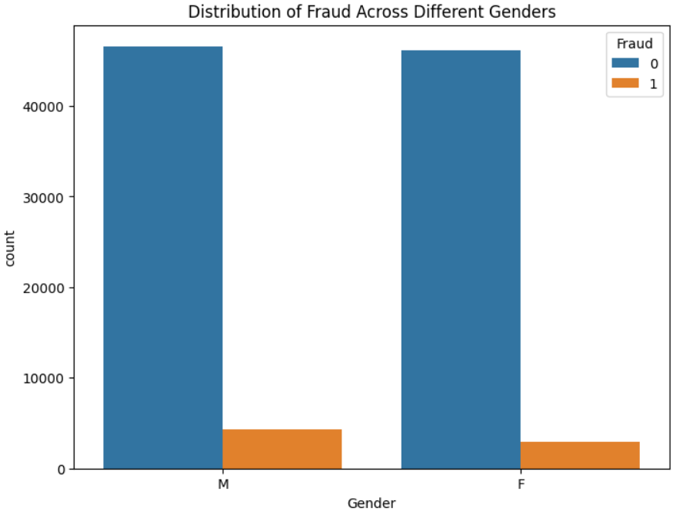
Fraud Demographics
Highest fraud in ages 30-60.
Slightly higher fraud in males.
Effective fraud prevention in UK.

Slide 10
Model Summary

Slide 11



Comparative Analysis After Hyperparameter Tuning
Random Forest outperformed Logistic Regression.
High precision, recall, F1-score, and ROC-AUC.
Effective in identifying fraudulent transactions.
Logistic Regression
Random Forest
Precision (0.54), Recall (0.95) for fraudulent transactions.
F1 Score (0.69) for fraudulent transactions
Struggles with minority class
ROC of 0.9819
Precision (0.97), Recall (0.81) for fraudulent transactions.
Higher F1 Score (0.88) for fraudulent transactions
Higher macro and weighted averages.
Higher ROC of 0.9922

Slide 12
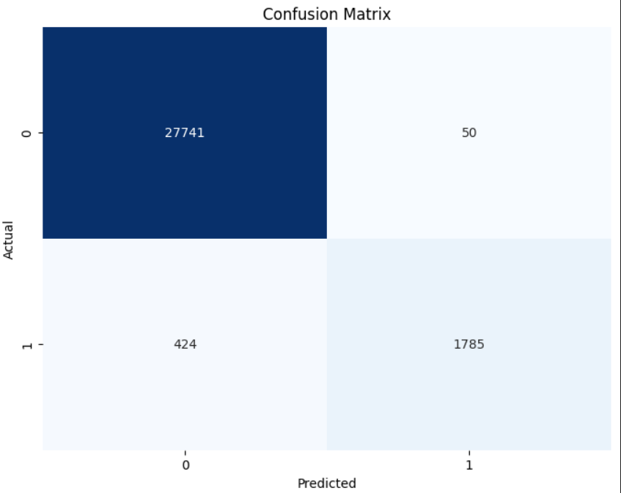
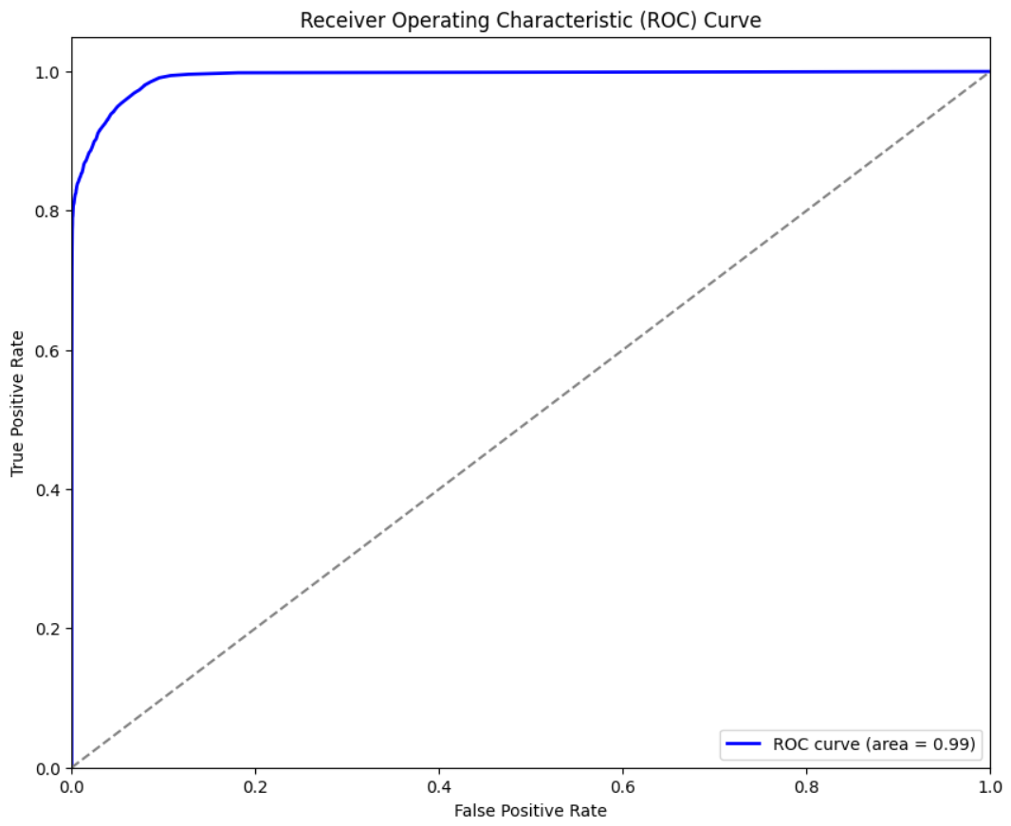
Random Forest Performance Accuracy Evaluation
Confusion Matrix
High True Negative Rate(27,741): Accurate non-fraud detection.
Low False Positive Rate(50): Minimal non-fraud misclassification.
Moderate True Positive Rate(1,785): Effective fraud detection.
Moderate False Negative Rate(424): Some fraud missed.
ROC Curve
AUC Value: 0.99, excellent performance.
Above Diagonal: Better than random guessing.
Model Effectiveness
Reliable tool for fraud detection.

Slide 13
Conclusion

Slide 14
Recommendation
Enhance security for online/high-risk transactions.
Target fraud prevention for specific days/entry modes.
Target high-risk age/merchant groups.
Strengthen regional fraud prevention
Use predictive models for real-time detection.

Slide 15
Future Work
Obtain high-quality datasets.
Handle class imbalance with advanced techniques.
Conduct longitudinal analyses.
Expand research to different industries and regions.
Include transaction patterns, device usage, and geolocation data.
Explore deep learning and anomaly detection methods.
Integrate models into real-time processing systems.

Slide 16
THANK YOU

